Slide 1
Segmentation of living cells
Adwait Kulkarni
Samarth Singh
CAS CS 585

Slide 2
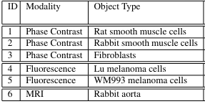
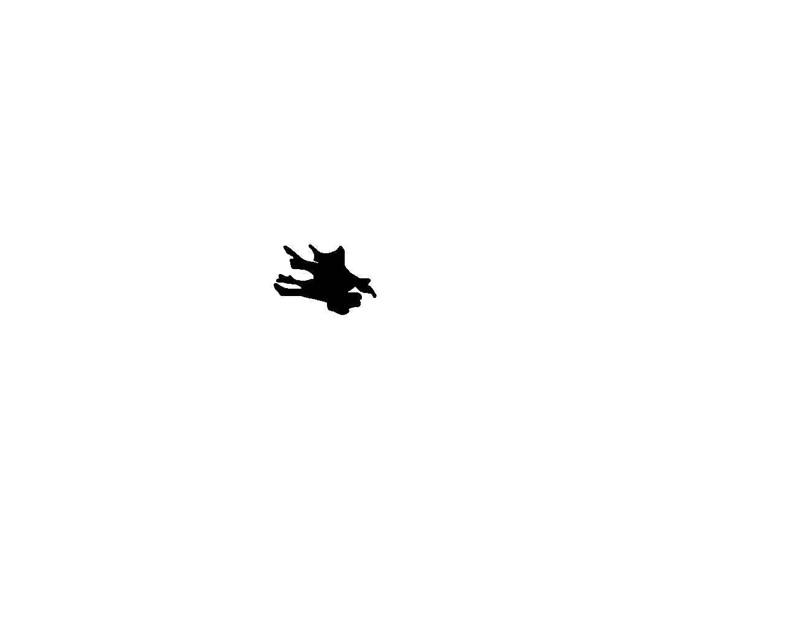
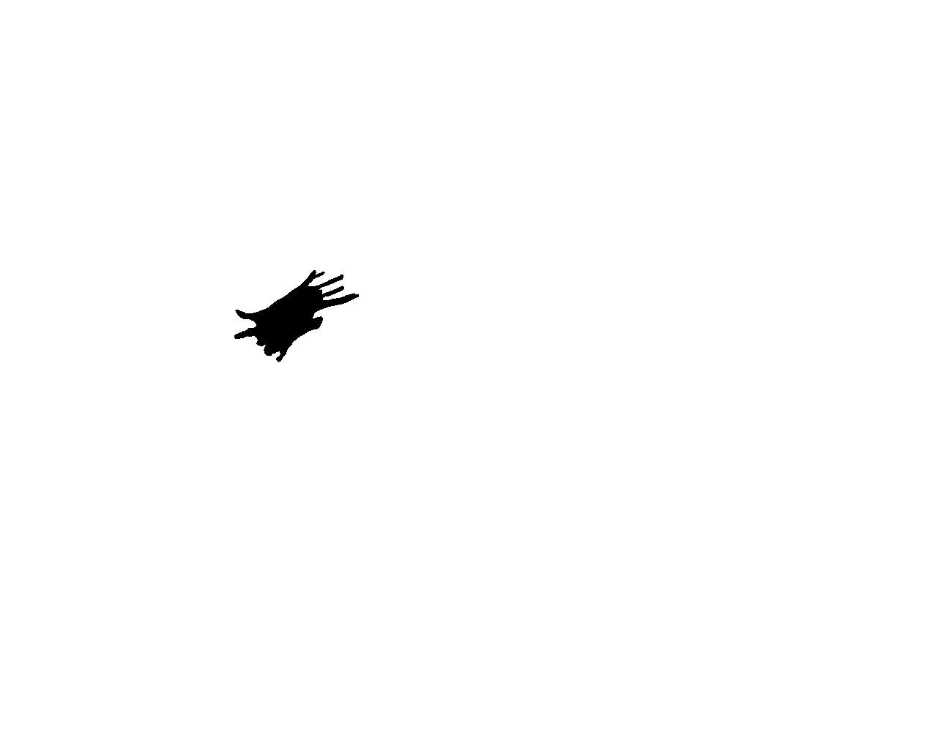
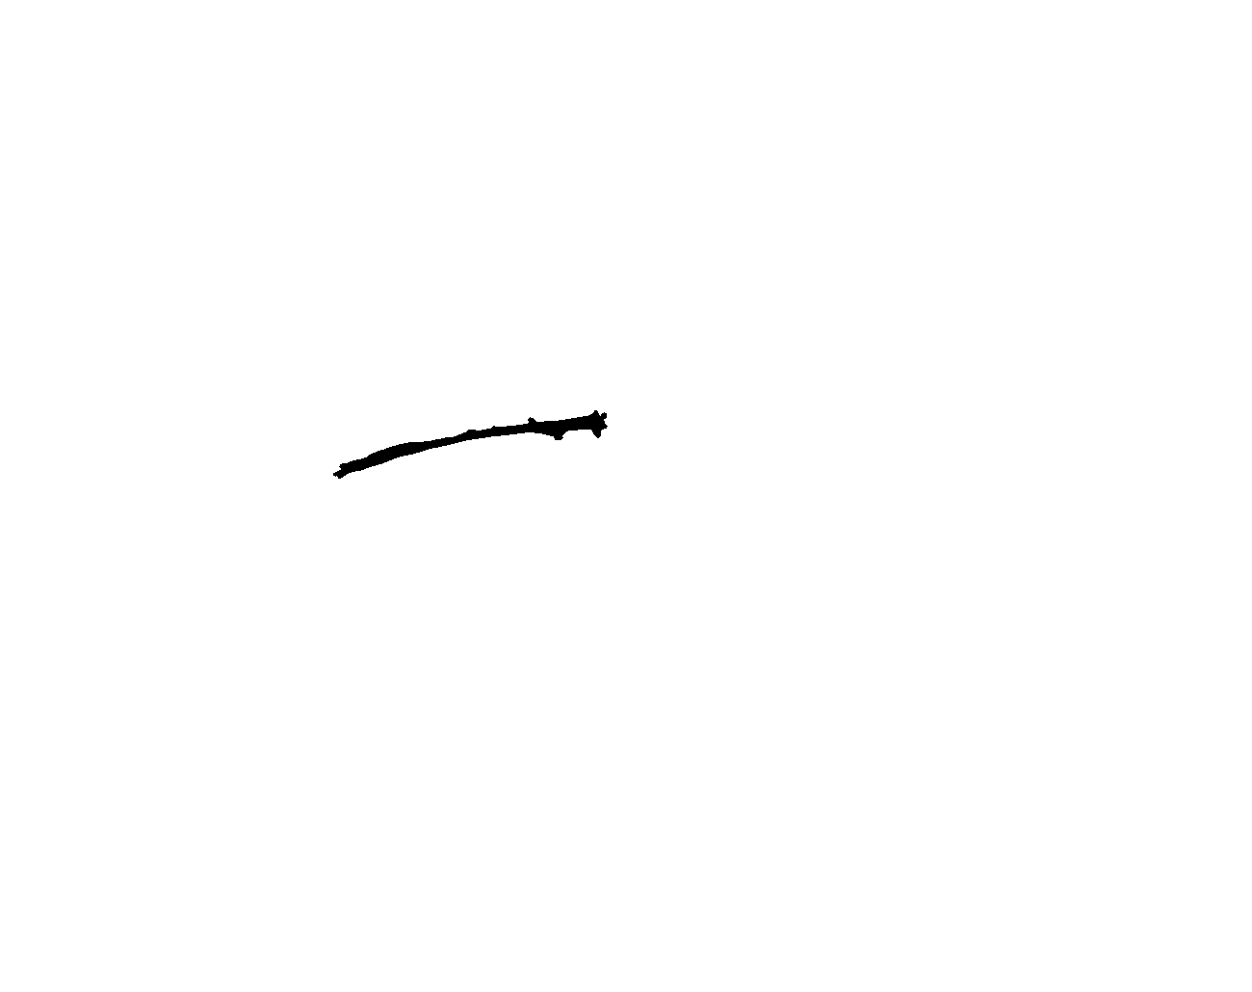
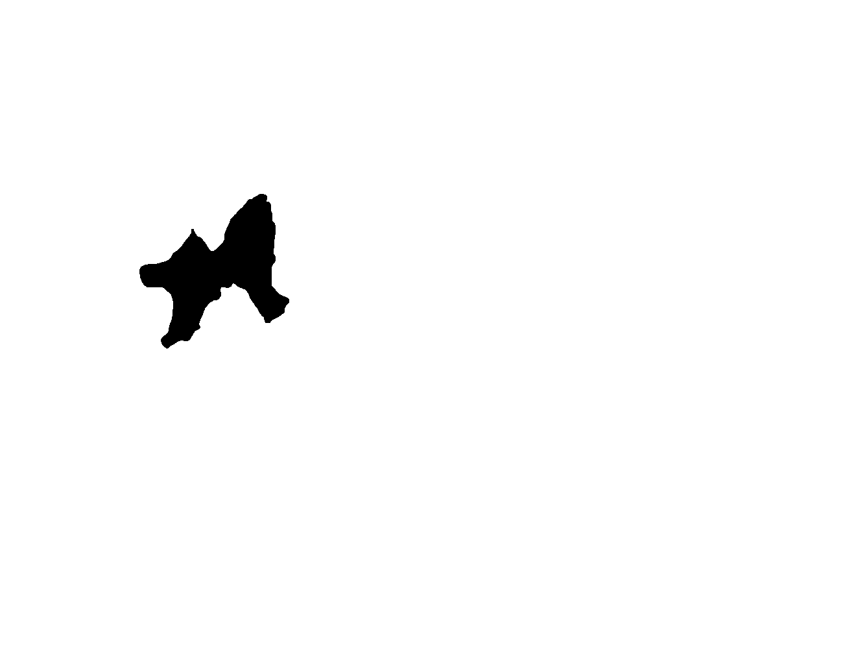
Data Preprocessing
Image Processing and Segmentation
Contrast Enhancement: Contrast Limited Adaptive Histogram Equalization (CLAHE) is applied to enhance image contrast.
Evaluation
Intersection over Union (IoU): Measures the overlap between predicted and ground truth masks.
Dice Coefficient: Quantifies the similarity between predicted and ground truth masks.
For each segmented image, IoU and Dice scores are calculated by comparing it with the corresponding ground truth.
Scores are printed for individual images, indicating the quality of segmentation.
Average IoU and Dice scores across all images are computed to assess the overall segmentation performance.
Raw images and corresponding gold standard (ground truth) images are loaded from specified directories.
The raw images are preprocessed and segmented using adaptive thresholding with edge detection techniques.
Edge Detection: Canny edge detector is utilized to detect edges in the contrast-enhanced image.
Adaptive Thresholding: Local thresholding is performed to binarize the contrast-enhanced image adaptively.
Combining Edge Detection and Thresholding: Edge-detected image and thresholded image are combined.
Morphological Operations: Morphological opening is applied to remove small objects from the segmented image.
Object Labeling: Connected components in the segmented image are labeled for further analysis.
Object Removal: Small objects are removed from the labeled image based on a predefined threshold.
Dataset information
BU-BIL is an image library which includes six datasets that represent three imaging modalities.
Gold Standard Images

Slide 3
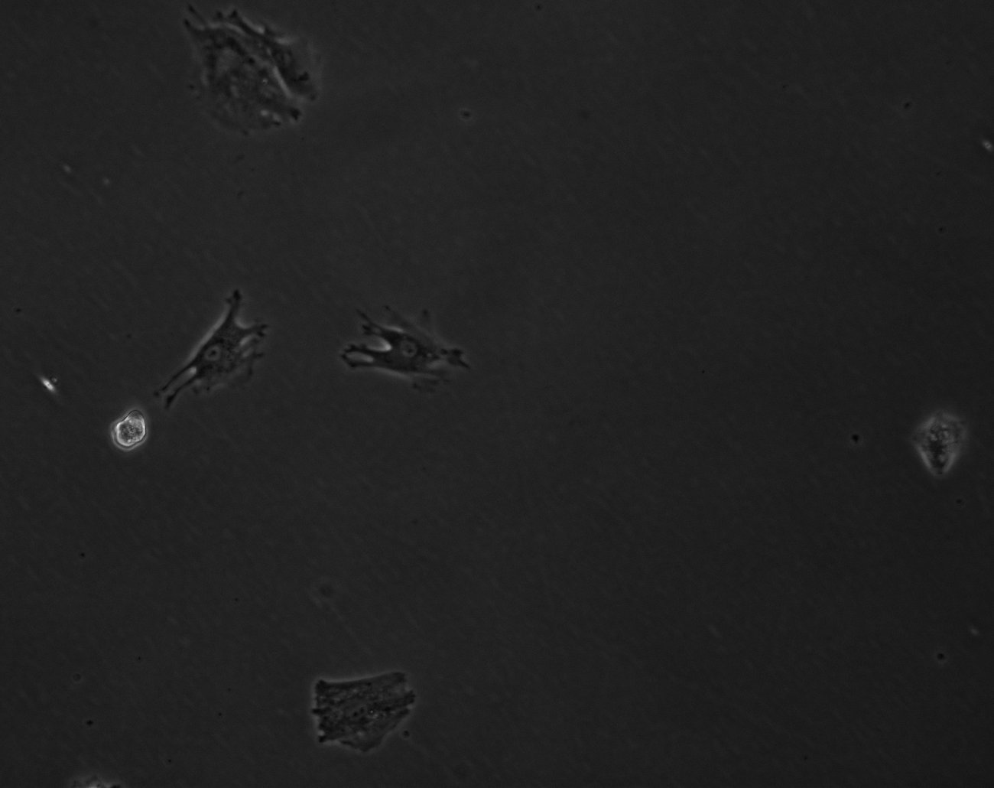
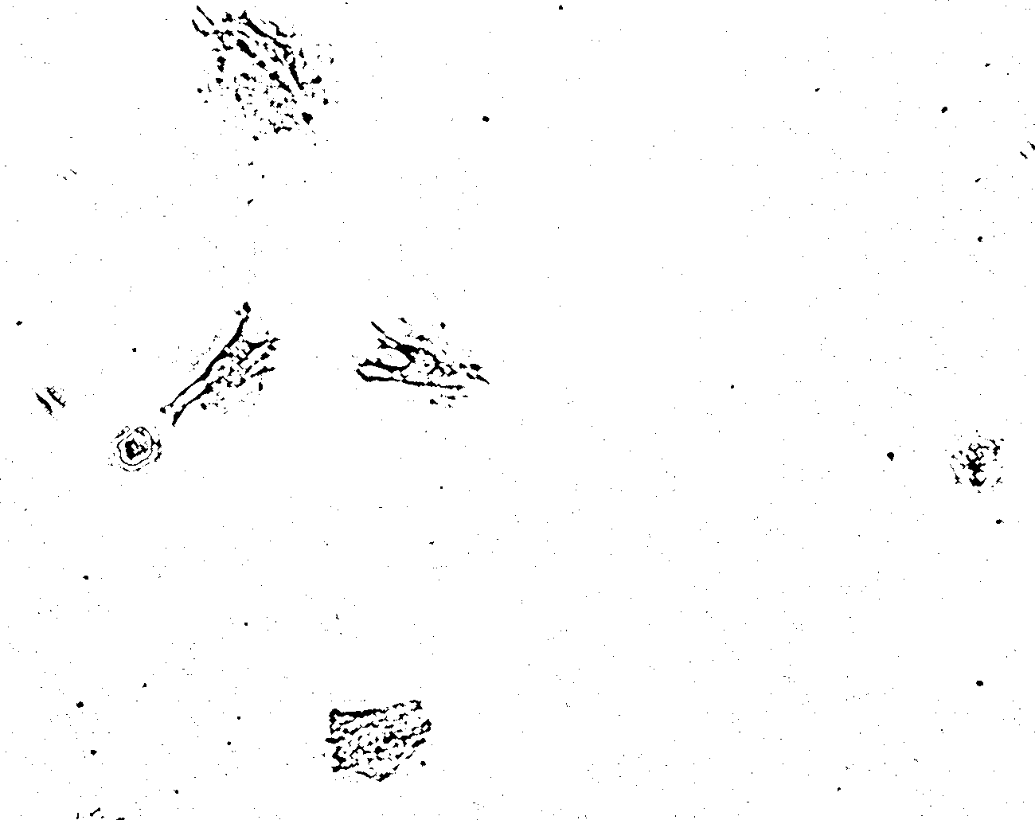
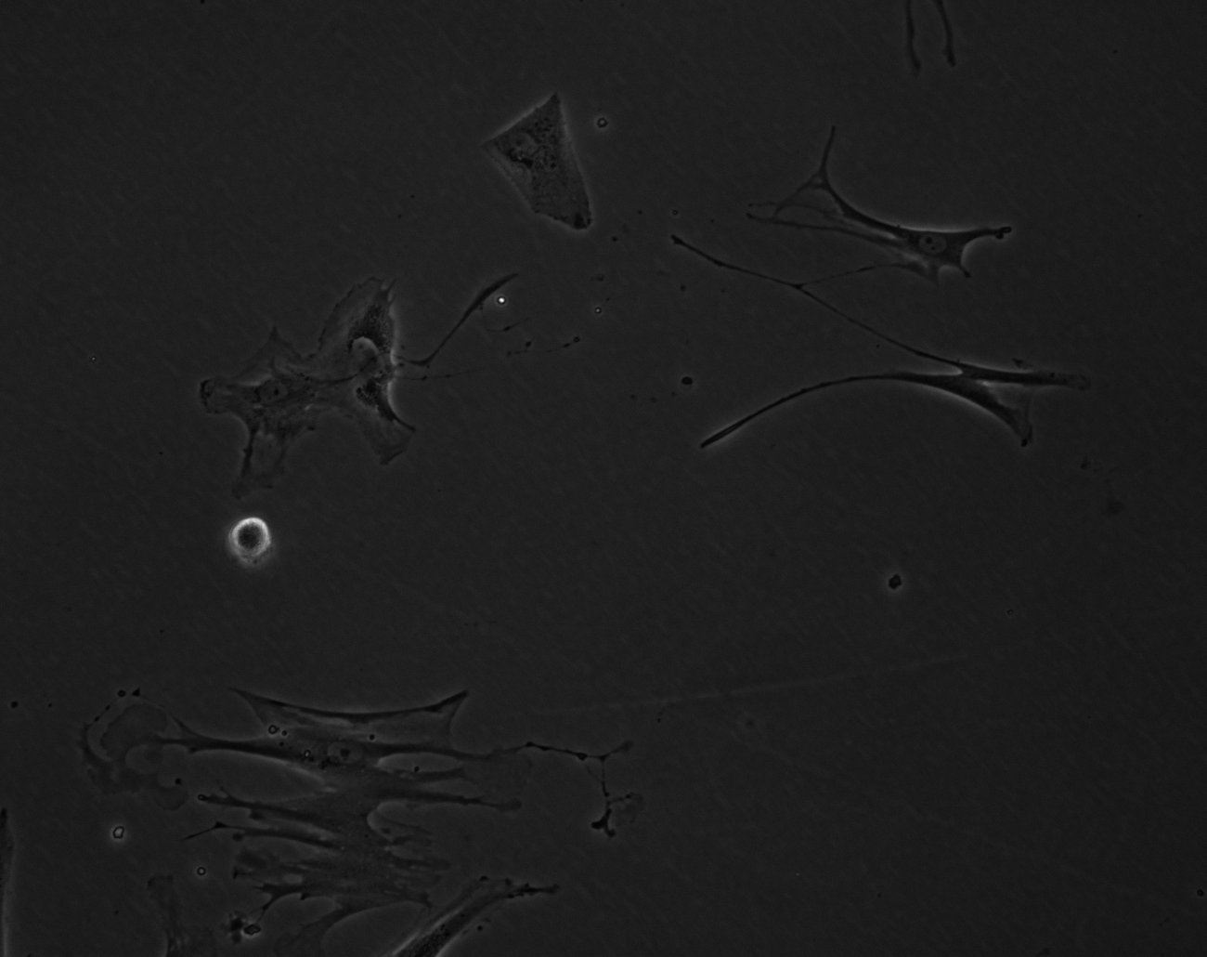
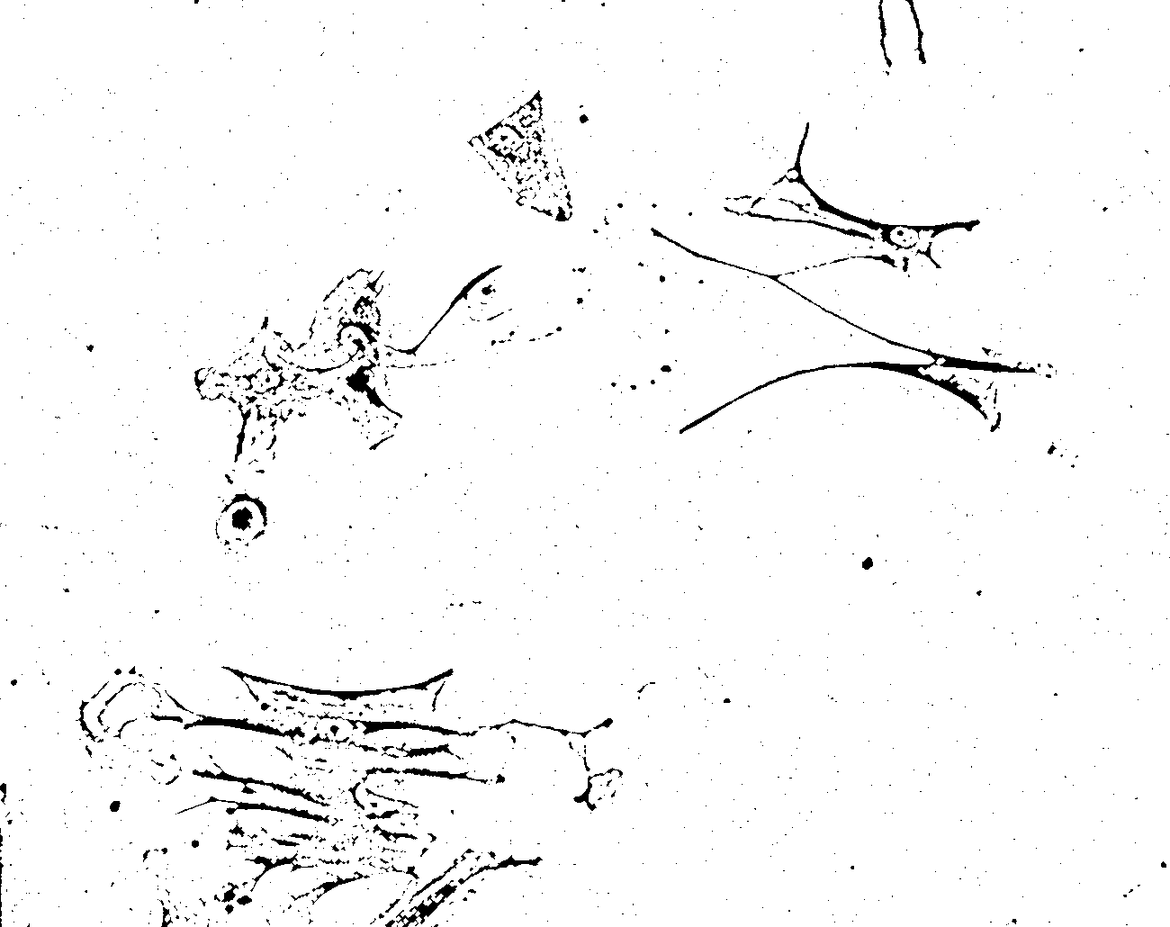
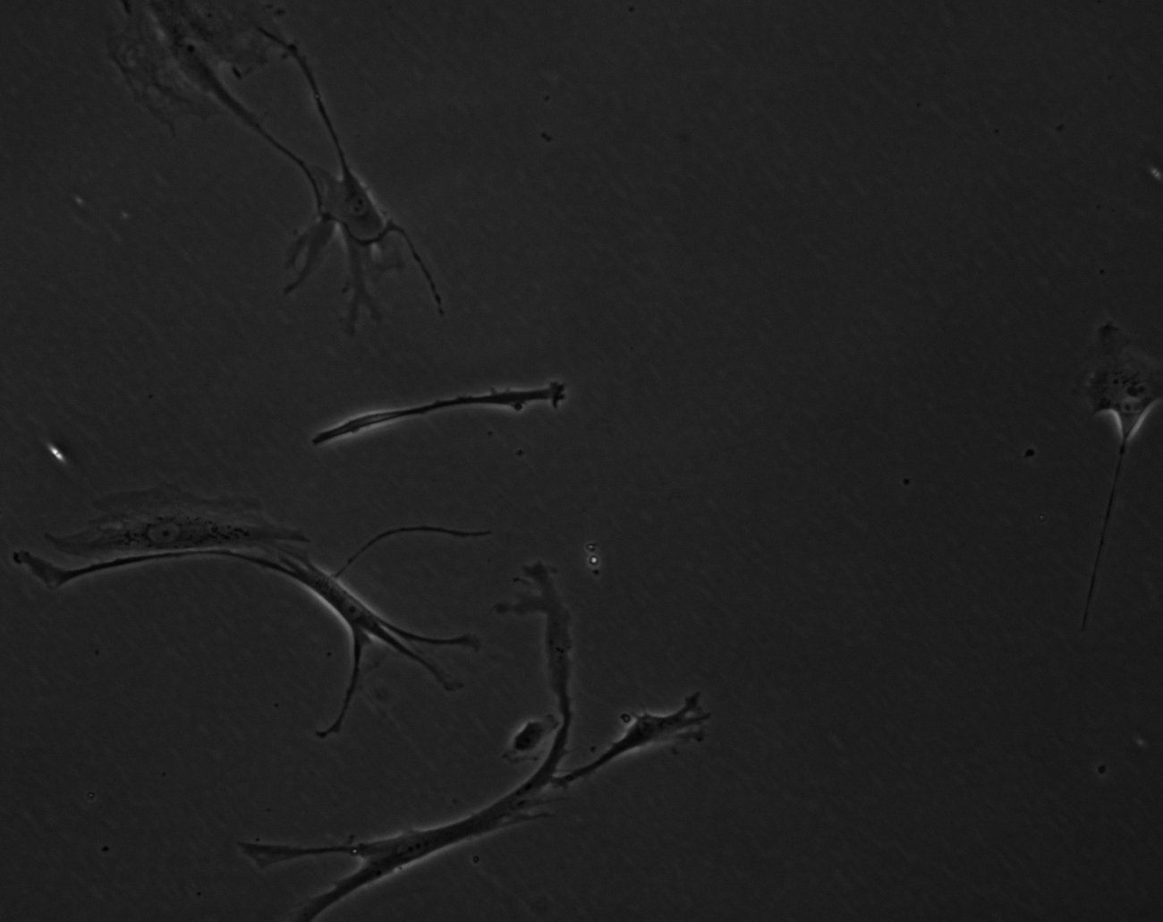
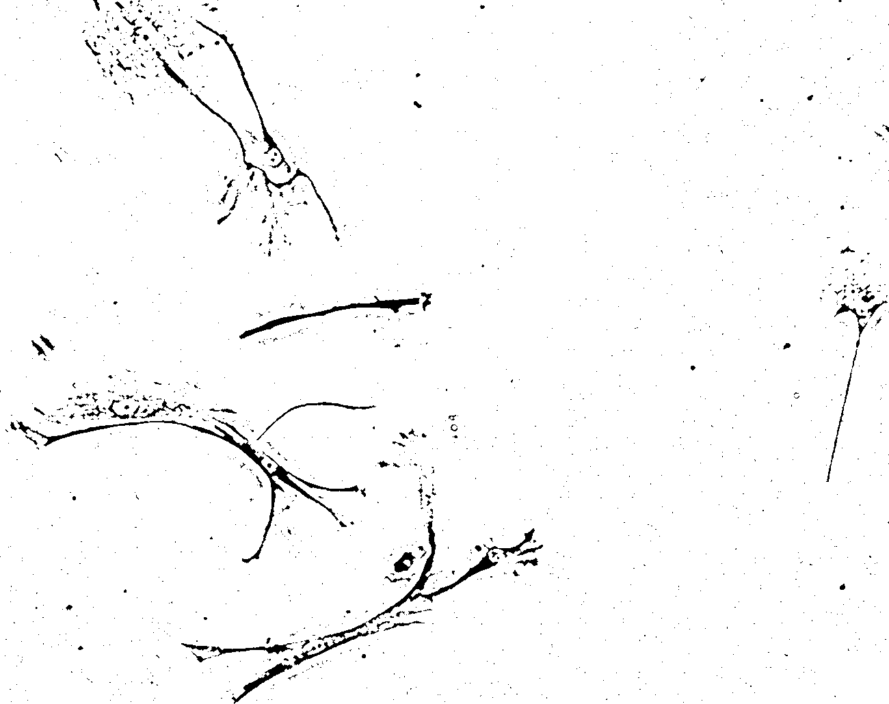
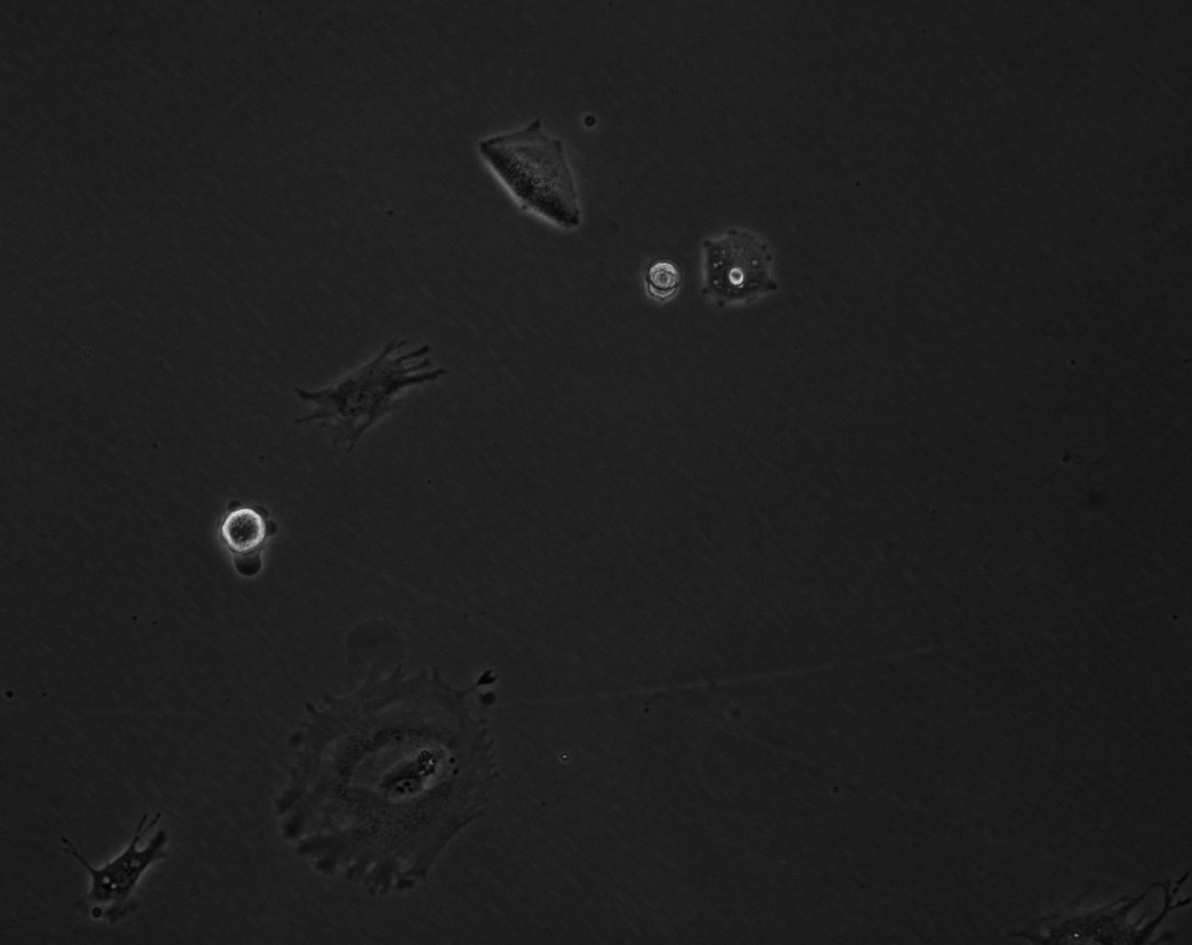
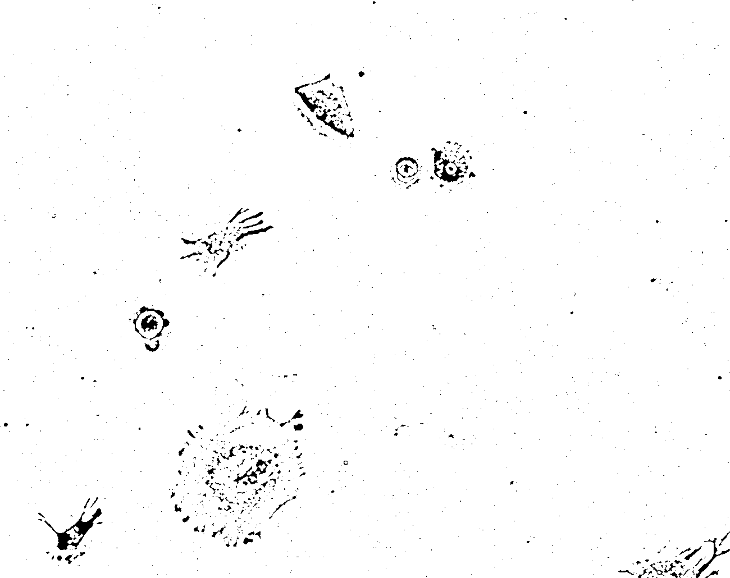
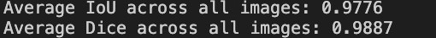
Raw Images
Segmented Images
Results

Slide 4
Thank you

